Slide 1
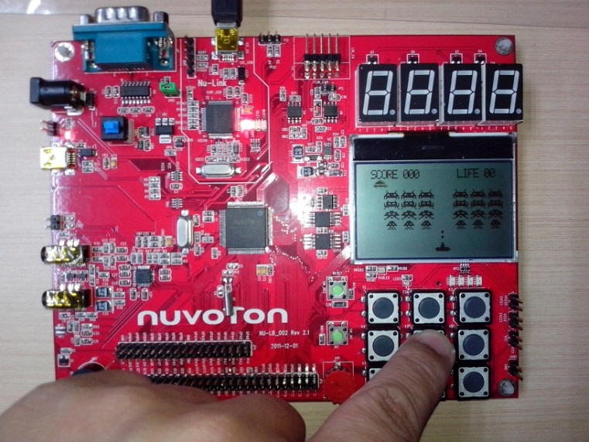
Outline
3.1_MCU_LCD.ppt
LCD Display Introduction
Exercise : Text Display
Lab. SPI interface to LCD (LCD_Text)
Lab. LCD Text with keypad (LCD_Keypad)
Exercise : Bitmap Display
Lab. LCD display Bitmap of Logo (LCD_Bmp)
Lab. LCD display Bitmap of Cartoon (LCD_Bmp_Cartoon)
Lab. LCD draw bitmap of object/icon (LCD_BmpDraw)
Lab. LCD move bitmap of object/icon (LCD_BmpMove)
Exercise : Graphics Drawing
Lab. LCD draw 2D graphics (LCD_Graph_2D)
Lab. LCD draw rotating line (LCD_Graph_LineRotation)
Lab. LCD draw sin/cosine waveform (LCD_Graph_SinCos)
Exercise : LCD Game Design (LCD_Game_Invader)

Slide 2
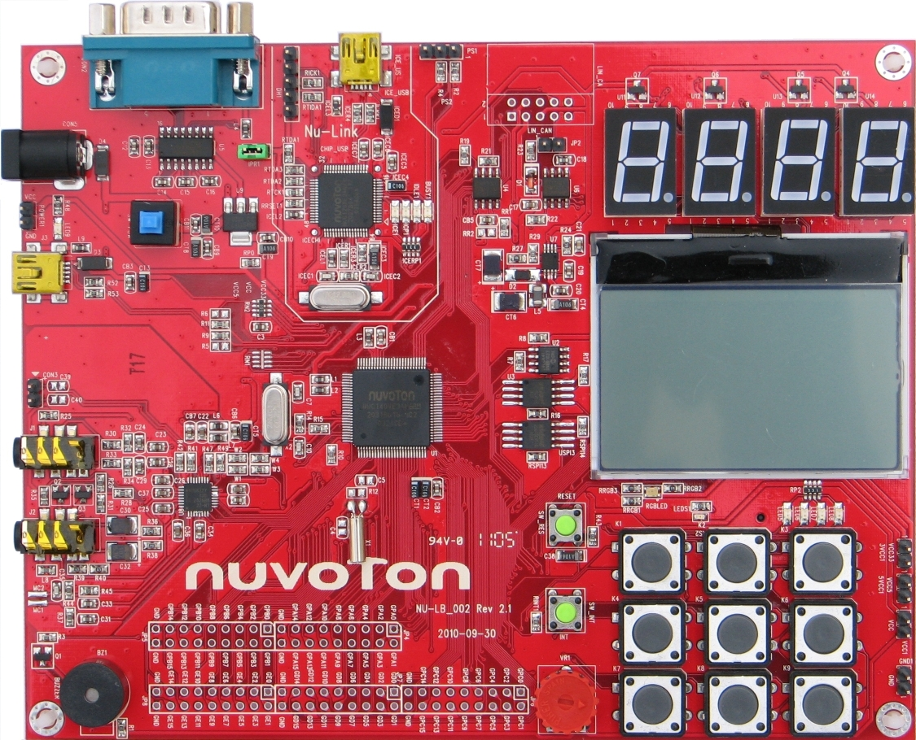
Nu-LB-NUC140 Learning Board
LCD
128x64 pixels
SPI interface

Slide 3
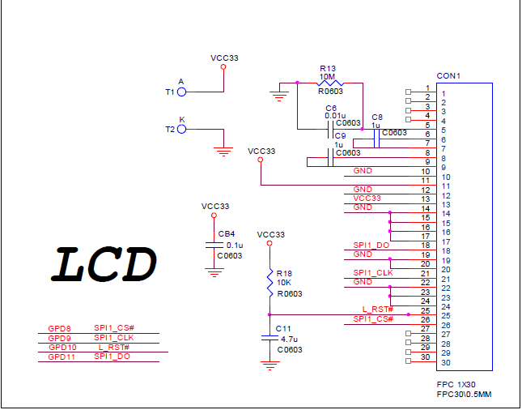
LCD schematic

Slide 4
SPI Pins used on Nu-LB-NUC140 board
SPI signals | SPI0 | SPI1 | SPI2 | SPI3
CS | GPC0 | GPC8 | GPD0 | GPD8
CLK | GPC1 | GPC9 | GPD1 | GPD9
DI0 (MISO) | GPC2 | GPC10 | GPD2 | GPD10
DO0 (MOSI) | GPC3 | GPC11 | GPD3 | GPD11
DI1 | GPC4 | GPC12 | GPD4 | GPD12
DO1 | GPC5 | GPC13 | GPD5 | GPD13
Nu-LB-NUC140 On-Board | I2S Codec (WAU8822) | SD/MMC | EEPROM (W25Q16CV) | LCD 128x64

Slide 5
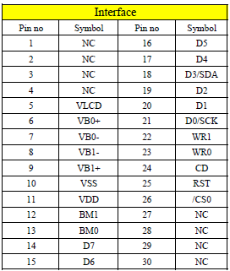
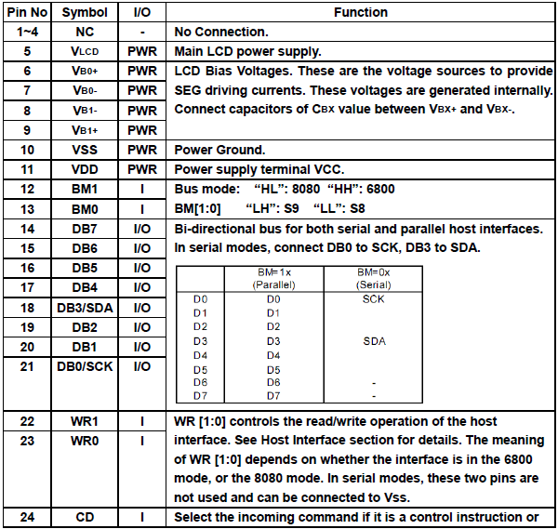
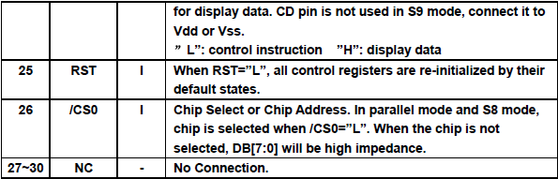
LCD Module Interface Signals

Slide 6
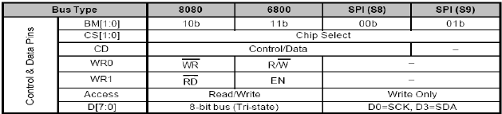
LCD module
http://www.computex.biz/PhotoPool2/201103/20113111045404.pdf
http://www.datamate-j.com/wp-content/uploads/2013/06/GFG128064A-FPFAB001SPEC.pdf

Slide 7
LCD Function Calls (LCD.h)
#define LCD_Xmax 128
#define LCD_Ymax 64
#define FG_COLOR 0xFFFF
#define BG_COLOR 0x0000
init_LCD(); → initialize LCD display
clear_LCD(); → clean up LCD display
printC(x, y, ascii_code); → print a character using font8x16 on LCD at location (x,y)
printC_5x7(x, y, ascii_code); → print a character using font 5x7 on LCD at location (x,y)
print_Line( line, text[]); → print a string (maximum = 16 charactors) on LCD (line no = 0,1,2,3)
printS(x, y, text[]); →. Print a string using font 8x16 on LCD at location (x,y)
printS_5x7(x, y, text[]); → print a string using font 5x7 on LCD at location (x,y)
draw entire LCD (128x64 pixels)

Slide 8
LCD Function Calls (LCD.h)
extern void draw_Bmp8x8(int16_t x, int16_t y, uint16_t fgColor, uint16_t bgColor, unsigned char bitmap[]);
extern void draw_Bmp32x8(int16_t x, int16_t y, uint16_t fgColor, uint16_t bgColor, unsigned char bitmap[]);
extern void draw_Bmp120x8(int16_t x, int16_t y, uint16_t fgColor, uint16_t bgColor, unsigned char bitmap[]);
extern void draw_Bmp8x16(int16_t x, int16_t y, uint16_t fgColor, uint16_t bgColor, unsigned char bitmap[]);
extern void draw_Bmp16x8(int16_t x, int16_t y, uint16_t fgColor, uint16_t bgColor, unsigned char bitmap[]);
extern void draw_Bmp16x16(int16_t x, int16_t y, uint16_t fgColor, uint16_t bgColor, unsigned char bitmap[]);
extern void draw_Bmp16x24(int16_t x, int16_t y, uint16_t fgColor, uint16_t bgColor, unsigned char bitmap[]);
extern void draw_Bmp16x32(int16_t x, int16_t y, uint16_t fgColor, uint16_t bgColor, unsigned char bitmap[]);
extern void draw_Bmp16x40(int16_t x, int16_t y, uint16_t fgColor, uint16_t bgColor, unsigned char bitmap[]);
extern void draw_Bmp16x48(int16_t x, int16_t y, uint16_t fgColor, uint16_t bgColor, unsigned char bitmap[]);
extern void draw_Bmp16x64(int16_t x, int16_t y, uint16_t fgColor, uint16_t bgColor, unsigned char bitmap[]);
extern void draw_Bmp32x16(int16_t x, int16_t y, uint16_t fgColor, uint16_t bgColor, unsigned char bitmap[]);
extern void draw_Bmp32x32(int16_t x, int16_t y, uint16_t fgColor, uint16_t bgColor, unsigned char bitmap[]);
extern void draw_Bmp32x48(int16_t x, int16_t y, uint16_t fgColor, uint16_t bgColor, unsigned char bitmap[]);
extern void draw_Bmp32x64(int16_t x, int16_t y, uint16_t fgColor, uint16_t bgColor, unsigned char bitmap[]);
extern void draw_Bmp64x64(int16_t x, int16_t y, uint16_t fgColor, uint16_t bgColor, unsigned char bitmap[]);
extern void draw_Pixel(int16_t x, int16_t y, uint16_t fgColor, uint16_t bgColor);
extern void draw_LCD(unsigned char *buffer);
Draw Bitmap

Slide 9
LCD.c
#include "stdio.h"
#include "string.h"
#include "NUC100Series.h"
#include "SYS.h"
#include "SPI.h"
#include "GPIO.h"
#include "LCD.h"
#include "Font5x7.h"
#include "Font8x16.h"
char DisplayBuffer[128*8];
void init_SPI3(void)
{
/* Configure as a master, clock idle low, 9-bit transaction, drive output on falling clock edge and latch input on rising edge. */
/* Set IP clock divider. SPI clock rate = 1MHz */
SPI_Open(SPI3, SPI_MASTER, SPI_MODE_0, 9, 1000000);
SPI_DisableAutoSS(SPI3);
}
Set SPI3 at 1MHz

Slide 10
LCD.c
void lcdWriteCommand(unsigned char temp)
{
SPI_SET_SS0_LOW(SPI3);
SPI_WRITE_TX0(SPI3, temp); // Write Data
SPI_TRIGGER(SPI3); // Trigger SPI data transfer
while(SPI_IS_BUSY(SPI3)); // Check SPI3 busy status
SPI_SET_SS0_HIGH(SPI3);
}
// Wrtie data to LCD
void lcdWriteData(uint8_t temp)
{
SPI_SET_SS0_LOW(SPI3);
SPI_WRITE_TX0(SPI3, 0x100 + temp); // Write Data
SPI_TRIGGER(SPI3); // Trigger SPI data transfer
while(SPI_IS_BUSY(SPI3)); // Check SPI3 busy status
SPI_SET_SS0_HIGH(SPI3);
}

Slide 11
LCD.c
// Set Address to LCD
void lcdSetAddr(uint8_t PageAddr, uint8_t ColumnAddr)
{
// Set PA
SPI_SET_SS0_LOW(SPI3);
SPI_WRITE_TX0(SPI3, 0xB0 | PageAddr); // Write Data
SPI_TRIGGER(SPI3); // Trigger SPI data transfer
while(SPI_IS_BUSY(SPI3)); // Check SPI3 busy status
SPI_SET_SS0_HIGH(SPI3);
// Set CA MSB
SPI_SET_SS0_LOW(SPI3);
SPI_WRITE_TX0(SPI3, 0x10 | (ColumnAddr>>4)&0xF); // Write Data
SPI_TRIGGER(SPI3); // Trigger SPI data transfer
while(SPI_IS_BUSY(SPI3)); // Check SPI3 busy status
SPI_SET_SS0_HIGH(SPI3);
// Set CA LSB
SPI_SET_SS0_LOW(SPI3);
SPI_WRITE_TX0(SPI3, 0x00 | (ColumnAddr & 0xF)); // Write Data
SPI_TRIGGER(SPI3); // Trigger SPI data transfer
while(SPI_IS_BUSY(SPI3)); // Check SPI3 busy status
SPI_SET_SS0_HIGH(SPI3);
}

Slide 12
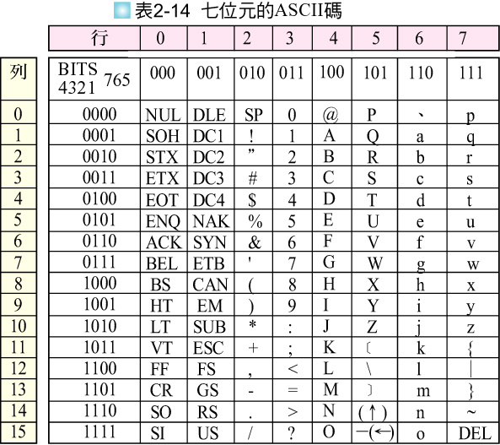
ASCII Code for Charactors

Slide 13
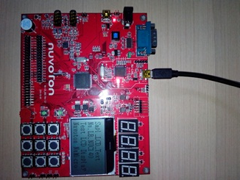
LCD_Text
int main(void)
{
SYS_Init();
init_LCD();
clear_LCD();
print_Line(0, "Smpl_LCD_Text ");
print_Line(1, "Nu-LB-NUC140 ");
print_Line(2, "Test LCD Display");
print_Line(3, "Nuvoton NuMicro ");
}

Slide 14
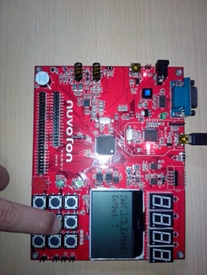
LCD_Keypad

Slide 15
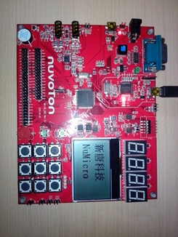
LCD_Bmp
Display bitmap
Step 1. use Paint to draw a 128x64 bitmap
Step 2. use bmp2asm to convert bitmap into hex
Step 3. cut and paste hex of bitmap to display buffer in Smpl_LCD_Bmp.c
Note: In order to draw bitmap, draw_LCD() should be added into LCD_Driver.c

Slide 16
draw_LCD()
// display buffer = 128x8 bytes (X=128, Y= 8 *8-bit)
void draw_LCD(unsigned char *buffer)
{
uint8_t x,y;
for (x=0; x<LCD_Xmax; x++) {
for (y=0; y<(LCD_Ymax/8); y++) {
lcdSetAddr(y,(LCD_Xmax+1-x));
lcdWriteData(buffer[x+y*LCD_Xmax]);
}
}
}
Set X,Y to LCD register
DisplayBuffer Data write to LCD

Slide 17
main()
int32_t main (void)
{
SYS_Init():
init_LCD();
clear_LCD();
while(1) {
draw_LCD(BMP_Logo_Nuvoton);
CLK_SysTickDelay(500000);
draw_LCD(BMP_Logo_University);
CL_SysTickDelay(500000);
}
}
Initialize & clear LCD
write nuvoton logo bitmap to LCD
write university logo bitmap to LCD

Slide 18
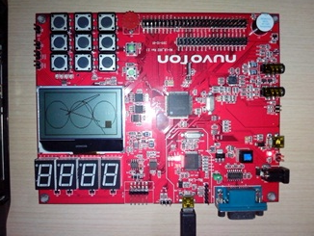
LCD_Graph_2D
Note: In order to draw graphics, 2D_Graphic_Driver.c is needed !

Slide 19
draw_Pixel(x,y, fgColor, bgColor)
// draw pixel into Display Buffer
void draw_Pixel(int16_t x, int16_t y, uint16_t fgColor, uint16_t bgColor)
{
if (fgColor!=0)
DisplayBuffer[x+y/8*LCD_Xmax] |= (0x01<<(y%8));
else
DisplayBuffer[x+y/8*LCD_Xmax] &= (0xFE<<(y%8));
lcdSetAddr(y/8,(LCD_Xmax+1-x));
lcdWriteData(DisplayBuffer[x+y/8*LCD_Xmax]);
}

Slide 20
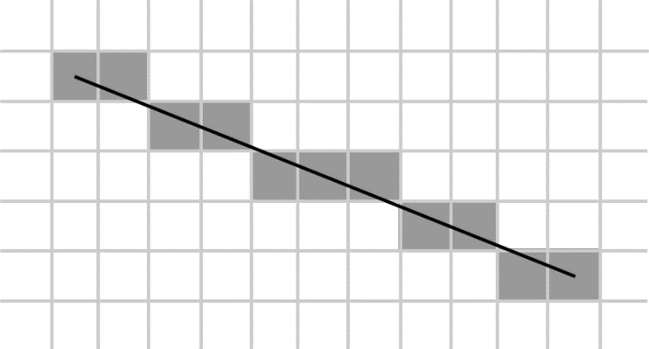


Bresenham Line-Drawing Algorithm
The Bresenham Line-Drawing Algorithm
布雷森漢姆直線演算法
Line equation :
    so, y =
Consider drawing a line on a raster grid where we restrict the allowable slopes of the line to the range . If we further restrict the line-drawing routine so that it always increments x as it plots, it becomes clear that, having plotted a point at (x,y), the routine has a severely limited range of options as to where it may put the next point on the line:
It may plot the point (x+1,y), or:
It may plot the point (x+1,y+1).
Use line slope to determine x,y increment to draw the pixel

Slide 21
Draw2D.h
extern void draw_Line(int x1, int y1, int x2, int y2, uint16_t fg_color, uint16_t bg_color);
extern void draw_Circl(int xc, int yc, int r, uint16_t fg_color, uint16_t bg_color);
extern void draw_Rectangle(int x0, int y0, int x1, int y1, uint16_t fg_color, uint16_t bg_color);
extern void fill_Rectangle(int x0, int y0, int x1, int y1, uint16_t fg_color, uint16_t bg_color);
extern void draw_Triangle(int x0, int y0, int x1, int y1, int x2, int y2, uint16_t fg_color, uint16_t bg_color);

Slide 22
Draw2D.c
void draw_Line(int16_t x1, int16_t y1, int16_t x2, int16_t y2, uint16_t fgColor, uint16_t bgColor)
{
int16_t dy = y2 - y1;
int16_t dx = x2 - x1;
int16_t stepx, stepy;
if (dy < 0) { dy = -dy; stepy = -1; } else { stepy = 1; }
if (dx < 0) { dx = -dx; stepx = -1; } else { stepx = 1; }
dy <<= 1; // dy is now 2*dy
dx <<= 1; // dx is now 2*dx
draw_Pixel(x1,y1, fgColor, bgColor);
if (dx > dy)
{
int fraction = dy - (dx >> 1); // same as 2*dy - dx
while (x1 != x2)
{
if (fraction >= 0)
{
y1 += stepy;
fraction -= dx; // same as fraction -= 2*dx
}
x1 += stepx;
fraction += dy; // same as fraction -= 2*dy
draw_Pixel(x1, y1, fgColor, bgColor);
}
} else {
int fraction = dx - (dy >> 1);
while (y1 != y2) {
if (fraction >= 0) {
x1 += stepx;
fraction -= dy;
}
y1 += stepy;
fraction += dx;
draw_Pixel(x1, y1, fgColor, bgColor);
}
}
}
based on Bresenham algorithm

Slide 23
Draw2D.c
void draw_Circle(int16_t xc, int16_t yc, int16_t r, uint16_t fgColor, uint16_t bgColor)
{
int16_t x = 0;
int16_t y = r;
int16_t p = 3 - 2 * r;
if (!r) return;
while (y >= x) // only formulate 1/8 of circle
{
draw_Pixel(xc-x, yc-y, fgColor, bgColor);//upper left left
draw_Pixel(xc-y, yc-x, fgColor, bgColor);//upper upper left
draw_Pixel(xc+y, yc-x, fgColor, bgColor);//upper upper right
draw_Pixel(xc+x, yc-y, fgColor, bgColor);//upper right right
draw_Pixel(xc-x, yc+y, fgColor, bgColor);//lower left left
draw_Pixel(xc-y, yc+x, fgColor, bgColor);//lower lower left
draw_Pixel(xc+y, yc+x, fgColor, bgColor);//lower lower right
draw_Pixel(xc+x, yc+y, fgColor, bgColor);//lower right right
if (p < 0) p += 4*(x++) + 6;
else p += 4*((x++) - y--) + 10;
}
}
http://willperone.net/Code/codecircle.php

Slide 24
draw_Rectangle & fill_Rectanlge
void draw_Rectangle(int16_t x0, int16_t y0, int16_t x1, int16_t y1, uint16_t fgColor, uint16_t bgColor)
{
int16_t x,y, tmp;
if (x0>x1) { tmp = x1; x1 = x0; x0 = tmp; }
if (y0>y1) { tmp = y1; y1 = y0; y0 = tmp; }
for (x=x0; x<=x1; x++) draw_Pixel(x,y0,fgColor, bgColor);
for (y=y0; y<=y1; y++) draw_Pixel(x0,y,fgColor, bgColor);
for (x=x0; x<=x1; x++) draw_Pixel(x,y1,fgColor, bgColor);
for (y=y0; y<=y1; y++) draw_Pixel(x1,y,fgColor, bgColor);
}
void fill_Rectangle(int16_t x0, int16_t y0, int16_t x1, int16_t y1, uint16_t fgColor, uint16_t bgColor)
{
int16_t x,y, tmp;
if (x0>x1) { tmp = x1; x1 = x0; x0 = tmp; }
if (y0>y1) { tmp = y1; y1 = y0; y0 = tmp; }
for (x=x0; x<=x1; x++) {
for (y=y0; y<=y1; y++) {
draw_Pixel(x,y, fgColor, bgColor);
}
}
}
draw vertical & horizontal lines
draw all pixels in the rectangle

Slide 25
main.c
#define PI 3.14159265
int32_t main (void)
{
SYS_Init();
init_LCD();
clear_LCD();
draw_Rectangle(0,0,127,63, FG_COLOR, BG_COLOR); // draw a rectangle
fill_Rectangle(10,10,20,20,FG_COLOR, BG_COLOR); // draw a box
draw_Circle(63,30,20,FG_COLOR, BG_COLOR); // draw a circle
draw_Line(20,0,60,50,FG_COLOR, BG_COLOR); // draw a line
draw_Triangle(20,40,90,10,60,60,FG_COLOR, BG_COLOR);// draw a triangle
}

Slide 26
Animation flow chart
Draw Object/Bitmap
on LCD Display
Delay for Vision
Erase Object/Bitmap
from LCD Display
Check Boundary
X, Y increment/decrement

Slide 27
Draw Objects
Draw a circle at x,y using foreground color
draw_Circle(x, y, r, fgColor, bgColor);
Or
draw_Bmp8x8(x, y, fgColor, bgColor, bitmap);

Slide 28
Display Objects
Delay for Vision (視覺暫留)
CLK_SysTickDelay(100000);

Slide 29
Erase Objects
Draw a circle at x,y using background color
draw_Circle(x, y, r, bgColor, bgColor);
Or
draw_Bmp8x8(x, y, bgColor, bgColor, bitmap);

Slide 30
Change Objects’ x,y by keypad
switch(keyin) {
case 1: Xdir =+1; Ydir =-1;
break;
case 2: Ydir = -1;
break;
case 3: Xdir =+1; Ydir =-1;
break;
case 4: Xdir =-1;
break;
case 5: break;
case 6: Xdir =+1; break;
case 7: Xdir=-1; Ydir=+1;
break;
case 8: Ydir=+1;
break;
case 9: Xdir=+1; Ydir=+1;
break;
}
1
2
3
4
5
6
7
8
9

Slide 31
Renew Objects’ x,y
(0,0)
(127,0)
x = x + Xdir * Xmov;
y = y + Ydir * Ymov;
(0,63)
(127,63)

Slide 32
Check Objects’ x,y to LCD boundary
(0,0)
(127,0)
wrap around on X
If (x<LCD_Xmin) x=LCD_Xmax;
If (x>LCD_Xmax) x=LCD_Xmin;
wrap around on Y
If (y<LCD_Ymin) y=LCD_Ymax;
If (y>LCD_Ymax) y=LCD_Ymin;
(0,63)
(127,63)

Slide 33
Collision Detection & Score
(0,0)
(127,0)
// compare if the bullet hit alien
If (bullet_x > alien_x) && (bullet_x < (alien_x +alien_x_size))
&& (bullet_y>alien_y) && (bullet_y <(alien_y +alien_y_size))
{
score ++;
alien_no --;
}
If (alien_no==0) { Game_Over(); };
(0,63)
(127,63)

Slide 34
LCD_PingPong
int32_t main (void){
int dirX, dirY;
int movX, movY;
uint16_t r;
uint16_t x, y;
uint16_t fgColor, bgColor;
UNLOCKREG();
DrvSYS_Open(50000000);
LOCKREG();
init_LCD();
clear_LCD();
x = X0; // circle center x
y = Y0; // circle center y
r = 5; // circle radius
movX = 3; // x movement
movY = 3; // y movement
dirX = 1; // x direction
dirY = 1; // y direction
bgColor = BG_COLOR;
set CPU running at 50MHz
initialize & clear LCD
initial value of x,y
initial value of x,y movement
initial value of x,y moving direction
initial background color (0x0000 for black)

Slide 35
LCD_PingPong
while(1) {
fgColor = FG_COLOR;
CircleBresenham(x, y, r, fgColor, bgColor); // draw a circle
LineBresenham(L_BAR_X,y-7, L_BAR_X,y+7, fgColor, bgColor); // draw left line
LineBresenham(R_BAR_X,y-7, R_BAR_X,y+7, fgColor, bgColor); // draw right line
CLK_SysTickDelay(100000); // adjustable delay for vision
fgColor = BG_COLOR;
CircleBresenham(x, y, r, fgColor, bgColor); // erase a circle
LineBresenham(L_BAR_X,y-7,L_BAR_X,y+7, fgColor, bgColor); // draw left line
LineBresenham(R_BAR_X,y-7,R_BAR_X,y+7, fgColor, bgColor); // draw right line
// boundary check for changing direction
if ((x-r) < L_BAR_X) dirX=1;
else if ((x+r) > R_BAR_X) dirX=-1;
else if ((y-r) < 0) dirY=1;
else if ((y+r) > LCD_Ymax) dirY=-1;
x = x + dirX * movX; // change x of circle center
y = y + dirY * movY; // change y of circle center
}}
Draw Object
Delay for Vision
Erase Object
Check Boundary
Increment X,Y

